Slide 1
The Asian Pacific Cultures
Celebrated during the
Year of Many Cultures at B-F Schools

Slide 2
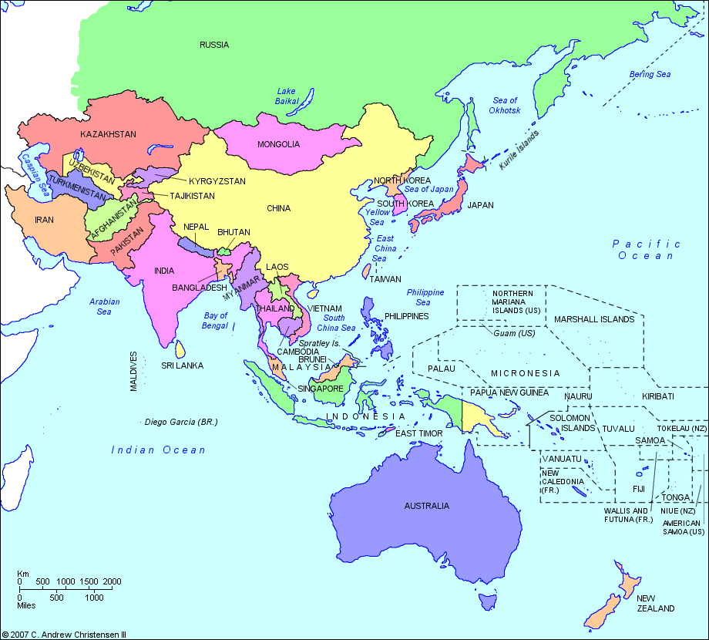
Population: Most Populous Continent -
Approximately 4.1 billion people (60% of the world's current human population) live in Asia.

Slide 3
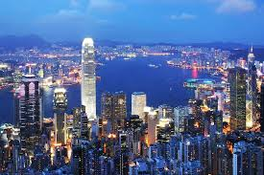
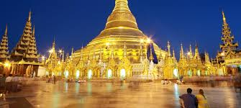
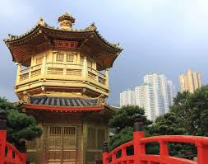
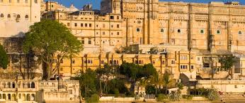
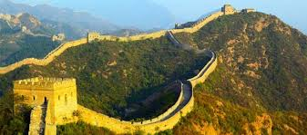
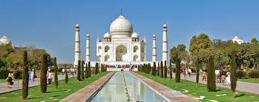

Slide 4
As
Asians are the fastest growing U.S. ethnic group

Slide 5
Manga and Anime
Manga
Since 1798
Japanese for ‘comic’
1960 started popularity in U.S.
Artistic Style - Large eyes, out of proportion body types and overt emotions
Anime
Animation originating in Japan
Designed for people of all ages
U.S. - creators/readers mainly male
Japan - both genders
http://www.today.com/id/13920877/ns/today-today_entertainment/t/anime-manga-gaining-popularity-us/

Slide 6
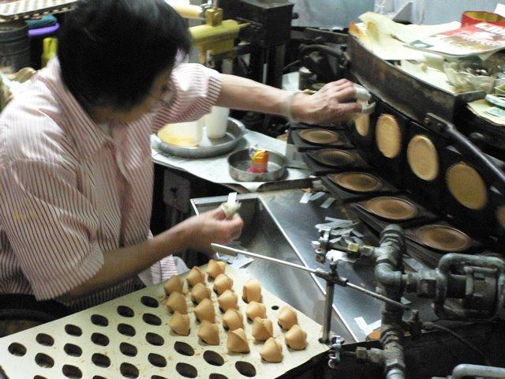
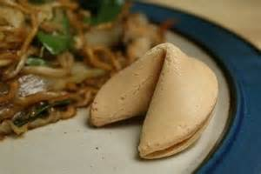
Origin?
Popular from WWII on - a free dessert!
Bible verses, Confucius sayings, jokes, lottery numbers and of course….fortunes!
Chinese Fortune Cookies
6
million

Slide 7
Over 1 billion people live in China | Some of the oldest human civilizations were in Asia | China is the 3rd largest country but only has one time zone | Asia is home of 9 of the 10 tallest buildings in the world
7 of the 10 most populated cities of the world are in Asia | Asia has the most varied landscape | Over 4,000 Chinese children are named “Olympic Games” | The giant panda, Asian elephant, tiger, Bactrian camel, king cobra, reticulated python, yak, Indian rhinoceros and the Komodo dragon are native to Asia

Slide 8
India Produces 12 Million Tons of Mangoes Every Year
It’s Illegal to Be Fat in Japan
In India, You Eat with Your Right Hand and Wipe with the Left
All Vietnamese Share the Same Birthday
The National Game in Afghanistan Is Goat Grabbing
Bhutan is the Only Country in the World That Bans the Sale of Tobacco
It’s Possible to Buy Canned Fresh Air in China
The Thai Celebrate New Years with Water Pistols
Newborns in Solapur are Thrown from a 50 Foot Tower for Good Luck
http://facts.net/asia-facts/nggallery/image/asia-facts-1/#f11

Slide 9
¼ of the people in the world live without electricity.
over 700 million are from South Asia
over 200 million are from East Asia
Did you know?

Slide 10
Almost half the world (over 3 billion people)
live on less than _________ a day.
At least ______ of humanity lives on less than ____ a day.
80% $2.50 $10
Did you know?

Slide 11
Number of children in the world. _____
Number of children in the world who live in poverty. _____
1 in 3 don’t have shelter.
1 in 5 don’t have safe water.
1 in 7 don’t have access to health care.
121 million children do not receive an education.
2.2 million children die each year because they aren’t immunized.
22,000 children die every day.
Did you know about the children?

Slide 12
Cultures matter.
People matter.
Learning about each other, respecting each other matters.

